Slide 1
Control statements in java

Slide 2
Outline
Decision-making statements
if statement
if-else statement
if-else-if ladder
switch statement
Looping Statements (iteration statements)
for loop
while loop
do-while loop
for-each loop
Jump Statements
break
continue
return

Slide 3
if statement
if statement tests a condition and executes the block of code if the condition is true
block of code in java is the code written inside { }
Syntax
if (condition) {
// code to be executed if condition is true
}

Slide 4
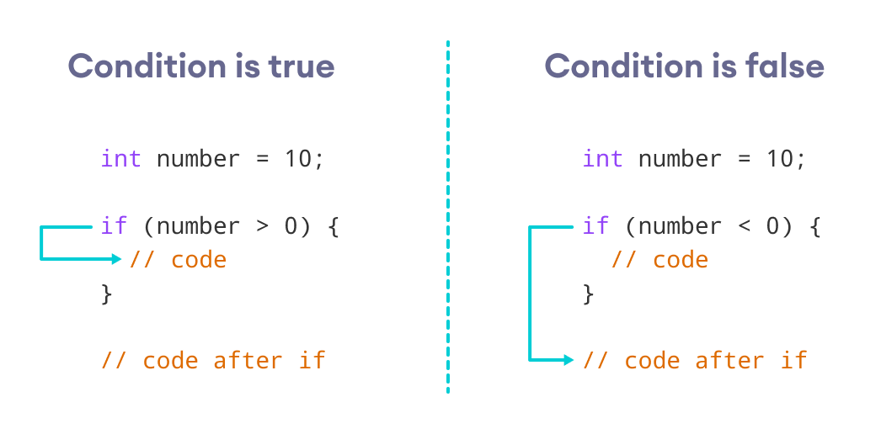

Slide 5
Example
Write a program that stores a float value in a variable called salary.
now check if the salary is above 2000, the program will print "rich", otherwise nothing happens

Slide 6
if-else
sometimes you need to control the behavior of your program.
if the condition is true, you want the program to do something
and if the condition is false, you want the program to do something else
in this case we need to use if-else statement
if (condition) {
// code to be executed if condition is true
} else {
// code to be executed if condition is false
}

Slide 7
Example
Write a simple program, in which the user enters a value and store it in a variable called mark
if the mark is above or equal to 50, the program will print "Pass"
if the mark is below 50 the program will print "Fail"

Slide 8
import java.util.Scanner; public class Main { public static void main(String[] args) { Scanner scanner = new Scanner(System.in); System.out.print("Enter a mark: "); double var1 = scanner.nextDouble(); if (var1 >= 50) { System.out.println("Pass"); } else{ System.out.println("Fail"); } scanner.close(); } }

Slide 9
if-else-if ladder
In the previous example we checked two conditions, what if more need to be checked?
For instance, assume that the user should enter a restaurant rate from 1 to 10
if the rate is less than 4, the program will print "Bad"
if the rate is between 4 and 7, the program will print "Acceptable"
if the rate is above 7, the system will print "Excellent"
in this case the if-else-if ladder is needed

Slide 10
Example
import java.util.Scanner; public class Main { public static void main(String[] args) { Scanner scanner = new Scanner(System.in); System.out.print("Enter a Rate: "); double var1 = scanner.nextInt(); scanner.close(); if (var1 < 4 && var1 > 0) { System.out.println("Bad"); } else if ( var1 >= 4 && var1 < 7){ System.out.println("Acceptable"); }else if ( var1 >= 7 && var1 <= 10){ System.out.println("Excellent"); }else { System.out.println("Not correct Rate"); } } }

Slide 11
Switch statement
Although if-else-if ladder is suitable for complex situations, sometimes one might need to use switch statement
Switch statement is lighter and easier to follow than if-else-if ladder
However, there are some limitations of switch the statement
Limited to Certain Data Types: char, byte, short, int, String, or an enum'
The switch statement checks for equality and cannot be used for relational checks (like greater than, less than).
An enum (short for "enumeration"). It's a way of defining a custom type where the allowable values are a predefined set of constants.
public enum Day { SUNDAY, MONDAY, TUESDAY, WEDNESDAY, THURSDAY, FRIDAY, SATURDAY; } Day a = Day.FRIDAY;

Slide 12
import java.util.Scanner; public class Main { public static void main(String[] args) { Scanner scanner = new Scanner(System.in); System.out.print("Enter a number: "); int var1 = scanner.nextInt(); scanner.close(); String dayName;
switch(var1) { case 1: dayName = "Monday"; break; case 2: dayName = "Tuesday"; break; case 3: dayName = "Wednesday"; break; default: dayName = "Invalid day"; } System.out.println(dayName); } }

Slide 13
Loops in java

Slide 14
Why loops
Loops are important to understand in any programming language
Reduces Code Repetition: Execute the same code multiple times without rewriting it.
Data Processing: Process elements in arrays or collections efficiently.
Automation: Perform repetitive tasks like searching, sorting, and more.
A loop in Java is used for executing a block of code repeatedly based on a condition or a set number of times

Slide 15
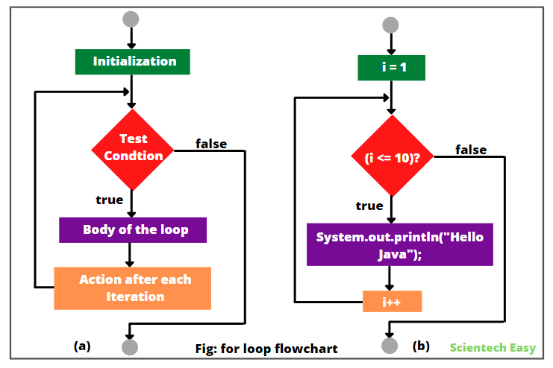
For loop
For loop in java is used when the number of iterations is known.
for(initialization; condition; step) {
// code to be executed
}
for(int i = 0; i < 10; i ++) {
System.out.println(i);
}

Slide 16
More complex for loop
in the for loop, you can combine two variables
possible but less common
Track the variables i and j and show the results (assignment)
for (int i = 0, j = 10; (i < 5 || j> 2) ; i++, j-=2) { System.out.println("i: " + i + ", j: " + j); }

Slide 17
Example
Write a program that prints the word "Hello there" 10 times
Loops are important when working with matrices, arrays (later)
Many more use cases
public class Main { public static void main(String[] args) { for (int i=0 ; i<100; i++){ System.out.println("Hello there"); } } }
public class Main { public static void main(String[] args) { System.out.println("Hello there"); System.out.println("Hello there"); System.out.println("Hello there"); System.out.println("Hello there"); System.out.println("Hello there"); System.out.println("Hello there"); System.out.println("Hello there"); System.out.println("Hello there"); .
.
System.out.println("Hello there"); } }

Slide 18
While loop
Helps in doing a repetitive task for undefined number of times.
There's no explicit section for initialization inside the loop syntax. It's typically done before the loop
There's no explicit section for updating. It's done inside the loop body
One of the important use cases of the while loop is games
Run an infinite loop
while(condition) {
// body of loop
}

Slide 19
Example
public class Main { public static void main(String[] args) { int i = 0; while (i<5) { System.out.println("Hello there"); i += 1; } } }
Hello there
Hello there
Hello there
Hello there
Hello there

Slide 20
do-while loop
do-while loop guarantees that the loop body is executed at least once because the condition is checked after the loop body is executed
It is usually needed when you want to display a menu and wait for a response
The action depends on the user input
Syntax
do {
// body of loop
} while (condition);

Slide 21
Example
You want a program that allows student to enter a number between 0-10.
The user should keep providing numbers until he enters 0 the program will exit
import java.util.Scanner; public class Main { public static void main(String[] args) { Scanner scanner = new Scanner(System.in); int number; do { System.out.print("Enter a number between 0 and 10: "); number = scanner.nextInt(); } while (number != 0); System.out.print("Bye!"); } }

Slide 22
Exercise
Write a program that allow the user to enter 4 numbers.
find the minimum value
find the maximum value
Calculate and print the average of entered values

Slide 23
Jump statements

Slide 24
Break
At some point in your loop, you want to stop the execution, particularly when a specific condition is satisfied
This stops further unnecessary iterations, which can improve the efficiency of the code
Syntax:
Example: Use case, in an ATM machine, a user is typically given a few attempts to enter their correct PIN. After three incorrect attempts, for security reasons, the system might "break" out of the input loop and temporarily lock the account, preventing further attempts
break;

Slide 25
Example: PIN Entry
import java.util.Scanner; public class Main { public static void main(String[] args) { Scanner scanner = new Scanner(System.in); final int CORRECT_PIN = 1234; int attempts = 0; final int MAX_ATTEMPTS = 3; while (true) { System.out.print("Enter your PIN: "); int enteredPin = scanner.nextInt(); if (enteredPin == CORRECT_PIN) { // using string.equals(another string) method to compare string values System.out.println("PIN correct. Access granted."); break; }
else { attempts++; if (attempts >= MAX_ATTEMPTS) { System.out.println("Too many incorrect attempts. Account locked!"); break; // Exit the loop and lock the account } else { System.out.println("Incorrect PIN. Try again."); } } } scanner.close(); } }

Slide 26
Continue
Continue is important when you need to skip one loop iteration
The loop will not terminate as the case of break
import java.util.Scanner; public class Main { public static void main(String[] args) { Scanner scanner = new Scanner(System.in); System.out.print("Enter number from 1 to 10 to ignore: "); int numberToIgnore = scanner.nextInt(); for(int i = 1; i <= 10; i++) { if (i == numberToIgnore) { continue; } System.out.println(i); } } }

Slide 27
Example
Imagine you're working at a fruit factory, where apples are being examined before being packaged and shipped.
If an apple has a defect, it won't be packaged.
Otherwise, it will be packaged and shipped

Slide 28
import java.util.List; public class Main { public static void main(String[] args) { List<String> apples = List.of("Good", "Bad", "Good", "Good", "Bad", "Good"); for (String apple : apples) { if (apple == "Bad") { System.out.println("Found a bad apple. Skipping..."); System.out.println("****"); continue; // skip the current apple and move to the next one } System.out.println("Packing the apple (function)."); System.out.println("Shipping the Package (function)."); System.out.println("................."); } } }

Slide 29
Return
Return is common when using function and methods
Its main task is to return a value from a function
sometimes it is used to terminate the function without returning any values
Return will exit the code and return to the function call
break exits the loop only

Slide 30
Break vs Return
public class Main { public static void main(String[] args) { int number = 1; for (int i=0;i<10;i++){ System.out.println(number); number++; if (number > 5){ break; } } System.out.println("The system continues"); } }
public class Main { public static void main(String[] args) { int number = 1; for (int i=0;i<10;i++){ System.out.println(number); number++; if (number > 5){ return; } } System.out.println("The system continues"); } }
1
2
3
4
5
The system continues
1
2
3
4
5

